Slide 1
Constrained Optimal Querying: Huffman Coding and Beyond
Shuyuan Zhang Jichen Sun Shengkang Chen
May 2022

Slide 2
Content
1
Introduction
5
Huffman Based Algorithm
2
Model
6
GBSC
3
DNA Detection Problem
7
Dealing with Problem
4
Battleship Problem
8
Future Work

Slide 3
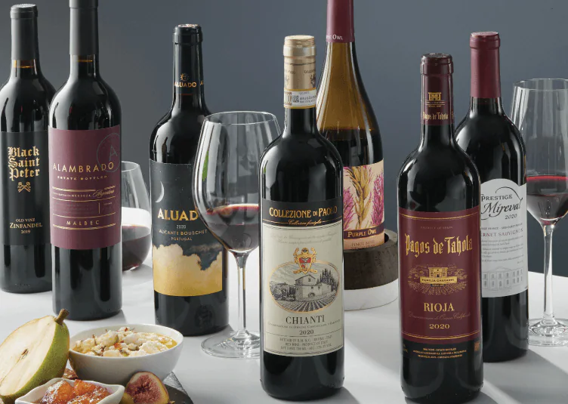
Introduction
Our work is inspired by a problem about wine in Cover’s textbook.
One of several bottles of wine is bad and we need to find the bad one.

Slide 4
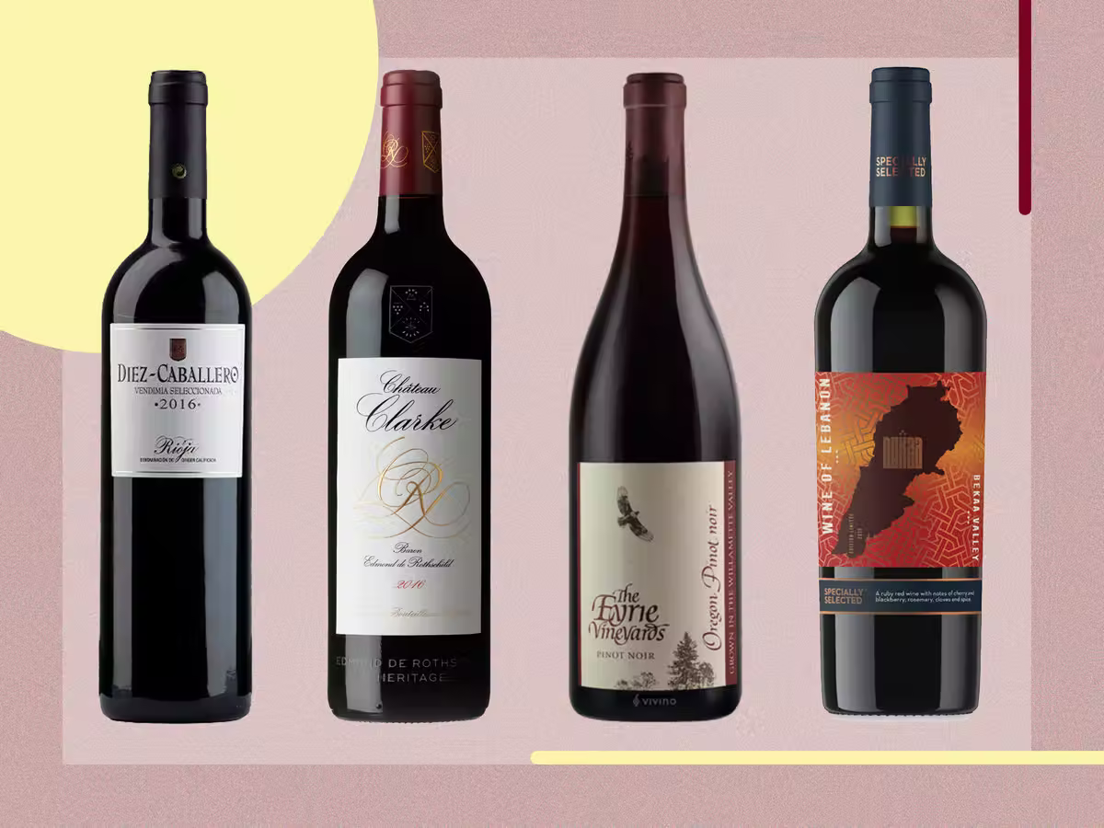
What if there are more bottles of bad wine?
Example:
There are four bottles of wines and two of them are bad.

Slide 5
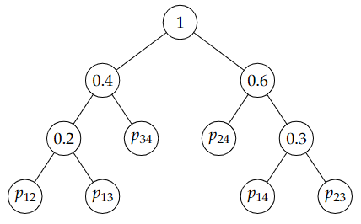
What if there are more bottles of bad wine?
The probability pij that the ith and jth bottles are bad is given by
(p12, p13, p14, p23, p24, p34) = (0.1, 0.1, 0.15, 0.15, 0.3, 0.2)
If we use Huffman tree again, the result is infeasible.

Slide 6

Model
Given a random variable X with alphabet X and its distribution p(x). We determine the value of X by asking questions such as "is X in set Si?", where Si ∈ A , ∀i.
The following two problems are specializations of this model.

Slide 7
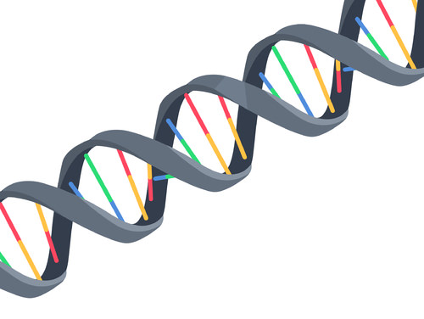
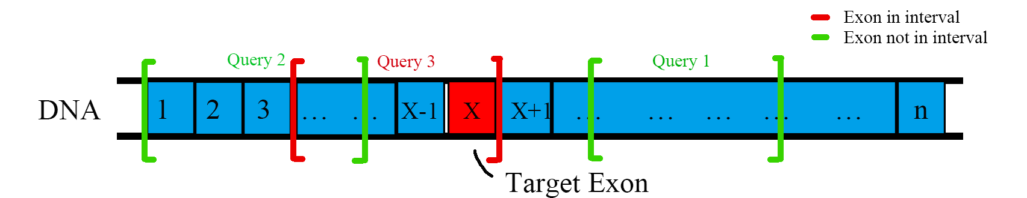
DNA Detection Problem
Finding a target exon from a set of candidate exons.
We can only examine continuous exons at each detection. How to minimize the expected number of detections?

Slide 8
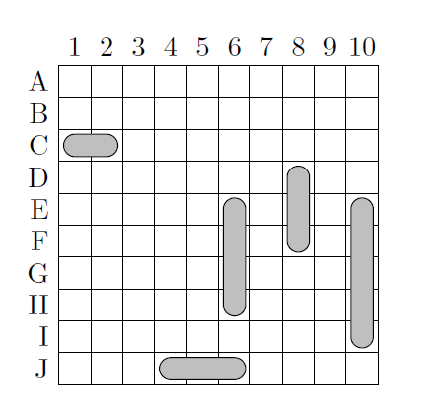
Battleship Problem
Finding the position of battleships on a board.
We can only “bomb” one grid and get whether we hit the battleship in one turn. How to minimize the expected number of “bombs”?

Slide 9
Huffman Based Algorithhm
Like Huffman coding, we try to merge the two nodes with minimum sum of probabilities in every iteration, but with some constraints.
a+b+c
a+b
a
b
c

Slide 10
First Try to Solving the DNA Detection Problem
Candidates of two nodes, A and B can merged iff:
1.A or B is continuous.
2.minA > maxB or minB > maxA
A+B
A
C
D
B

Slide 11
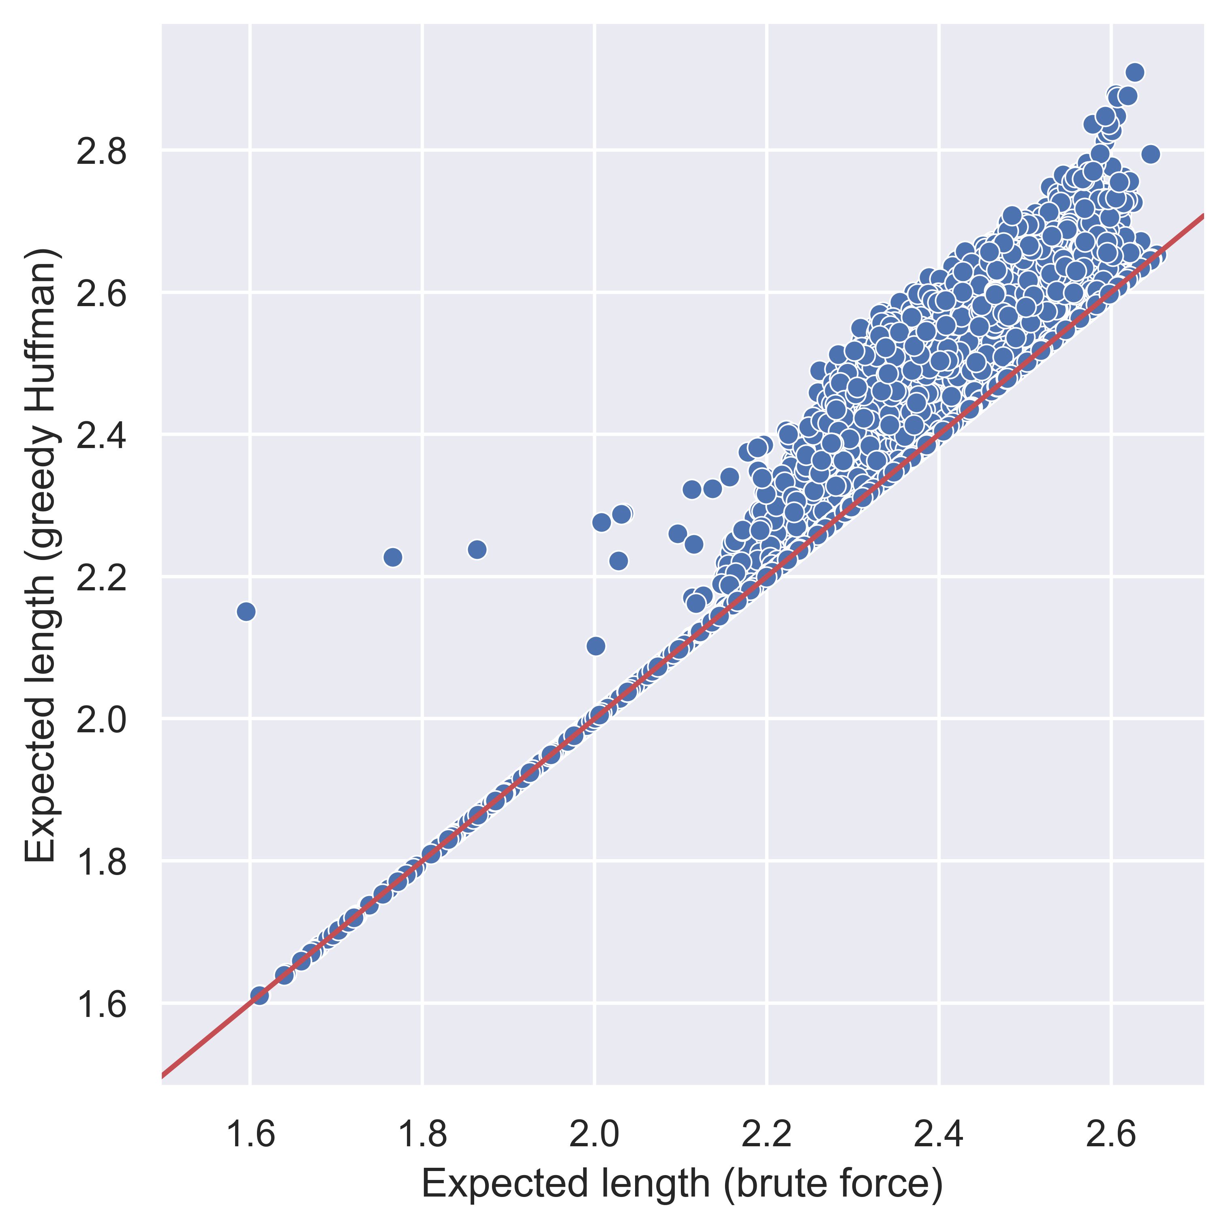
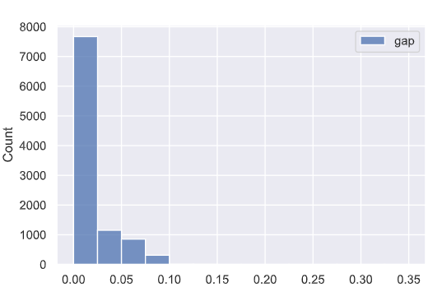
First Try to Solving the DNA Detection Problem
The result compared with brute force algorithm.

Slide 12
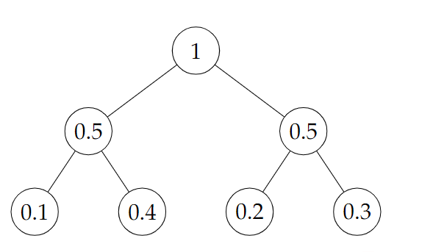
Greedy Binary Separation Coding (GBSC)
Principle: Divide the set as equally as possible.
Different from Huffman algorithm, this algorithm construct the decision tree from top to bottom.
Example:{0.1, 0.2, 0.3, 0.4}
It can be proved that that the expected code length for GBSC is not longer than Shannon coding.

Slide 13
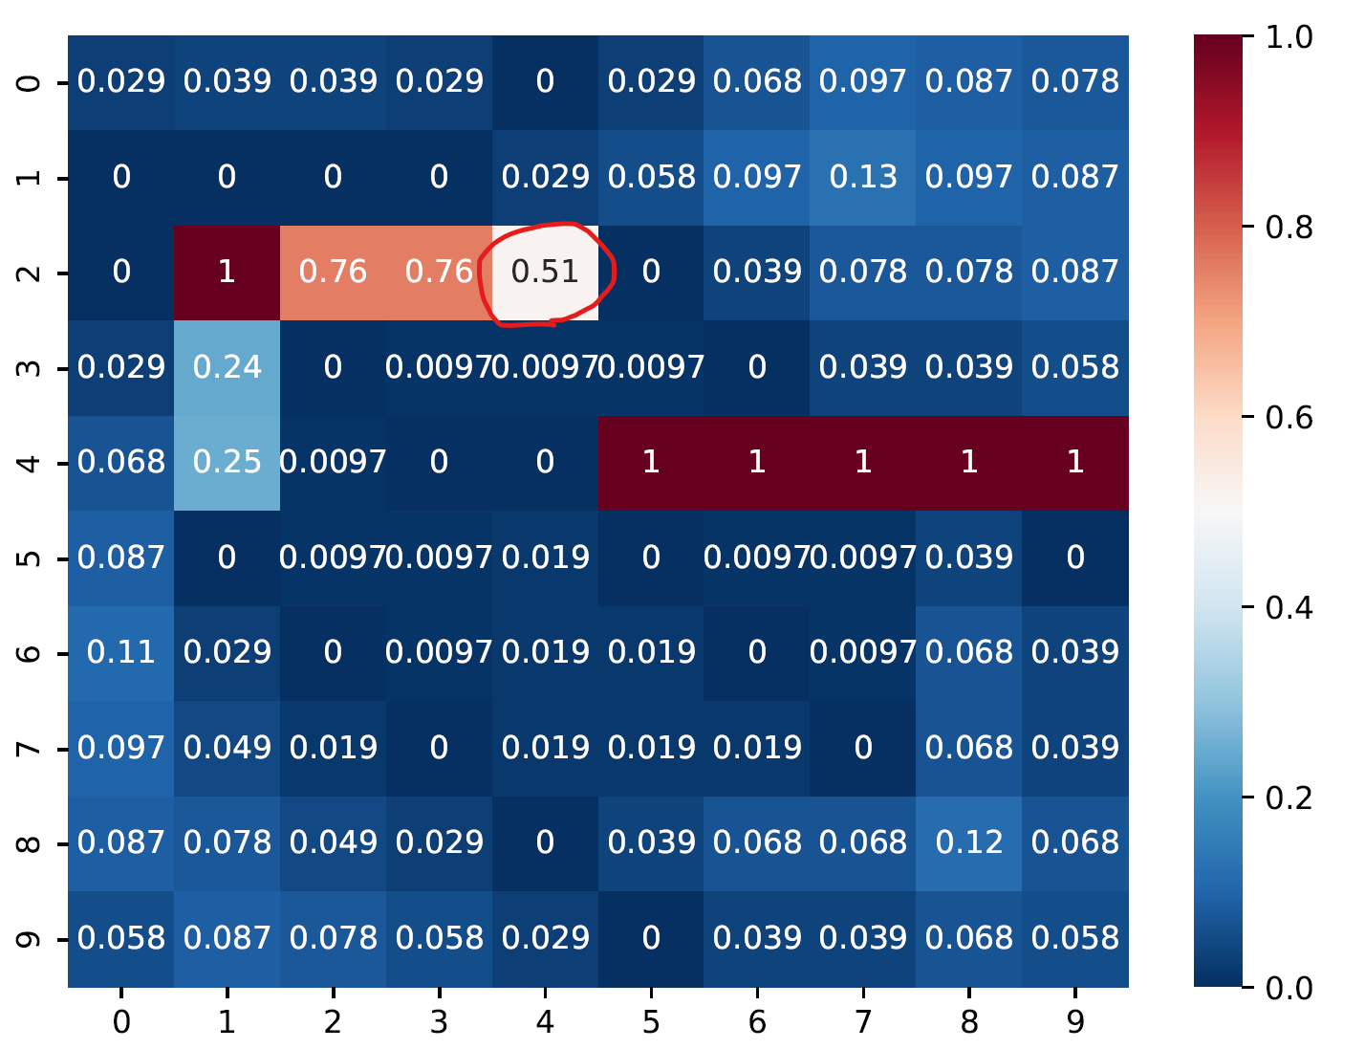
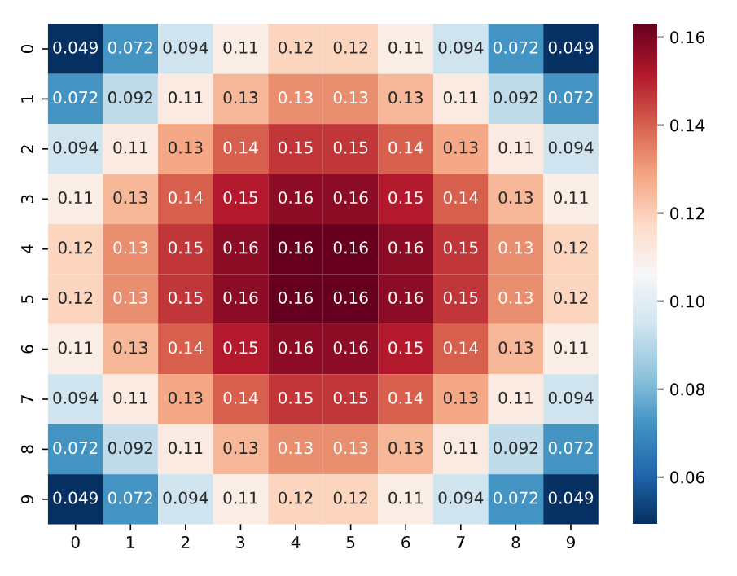
Dealing with 1-player Battleship Problem
Principle: Divide the set as equally as possible.
Always choose the grid with hit probability closest to 0.5

Slide 14
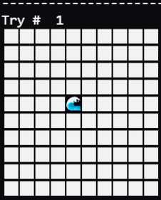
Dealing with 1-player Battleship Problem
Consider 3 ships of length 5, 4 and 3. The GIF on the right show the game process of the algorithm.

Slide 15
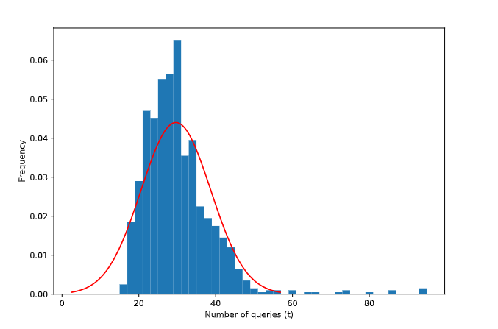
Test Results
The theoretical best average is 21, and the picture on the right shows the distribution of test results.

Slide 16

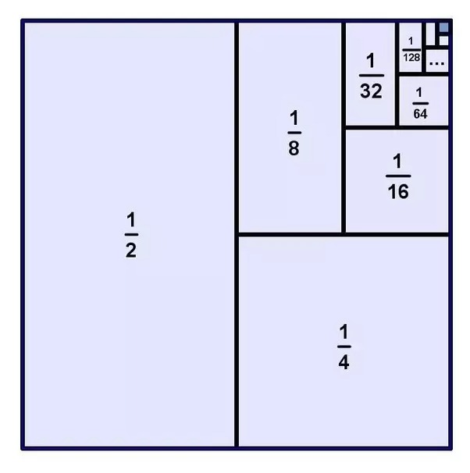
Another Try to Solving the DNA Detection Problem
Using GBSC to solve the DNA detection problem
Divide the set of exons as equally as possible.
One of the two subsets must be continuous.
Remove the subset that don’t have target in it after one detection.

Slide 17
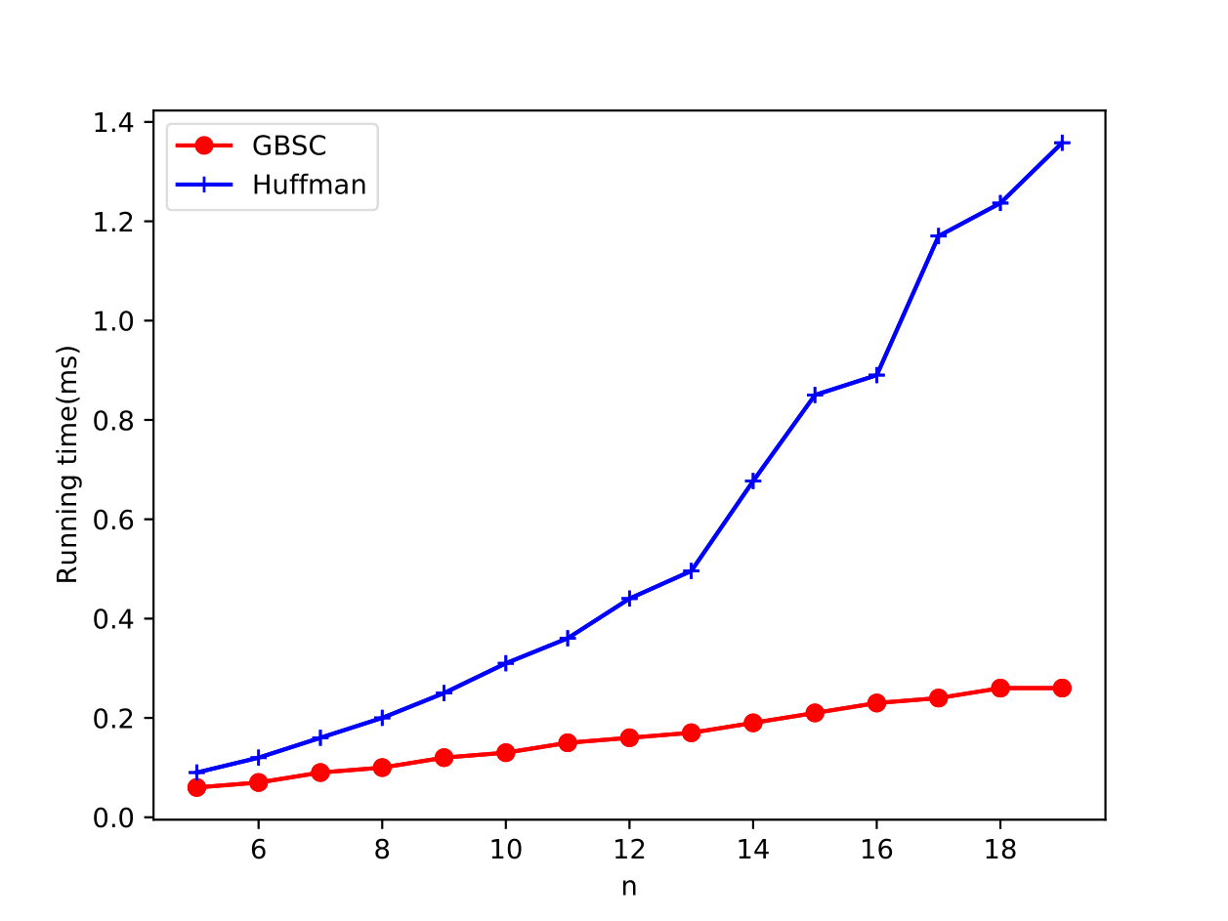
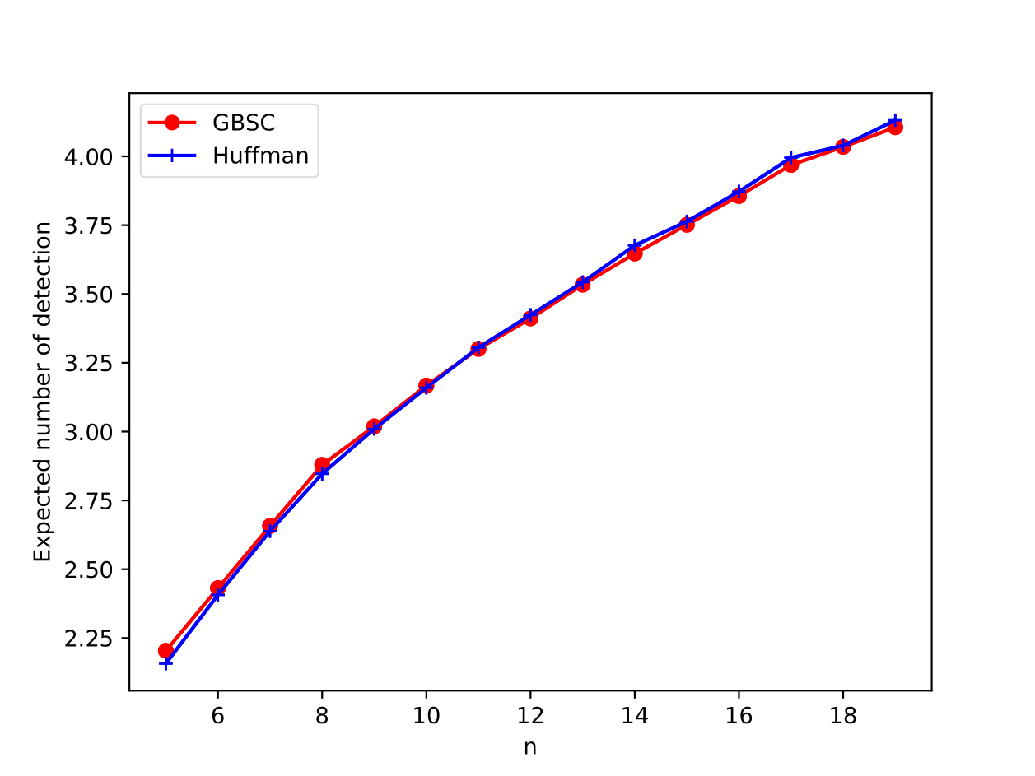
Compared with the First Try

Slide 18
Future Work
Multi-exon detection
NP-hard proof
Non-independent distribution
Algorithm optimization
…

Slide 19
Our Code
Our code is stored at
https://github.com/MadCreeper/Constrained-Optimal-Querying-Huffman-Coding-and-Beyond

Slide 20
Thanks
Many thanks to Prof. Cheng and the teaching assistants for their dedication in this course!

